Slide 1
Samsung Innovation Campus
Artificial Intelligence Course
Notes:
Note:
1

Slide 2

Breast Cancer detection
(Using deep learning)
Teamwork:
Eng. Zeiad Omar Youssif
Eng. Yasmin Osama Soliman
Facilitator: Eng. Mariam Ashraf
Notes:
Note:
2

Slide 3
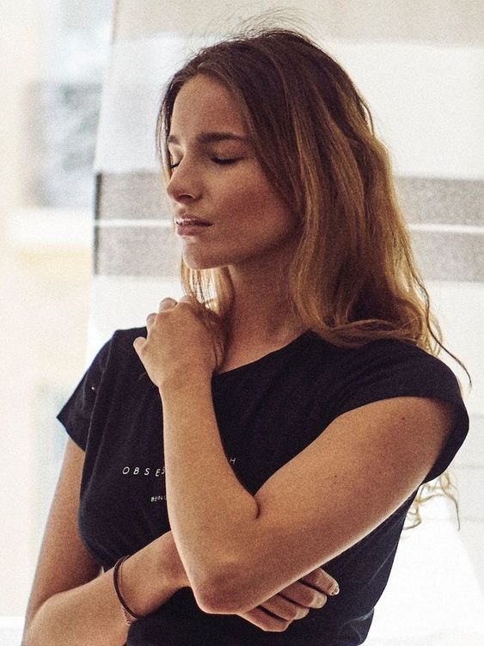
Rose’s story…
Rose is a middle-aged girl, studying at university and going about her daily activities normally
Until her vitality and performance began to be affected when some strange symptoms began to appear on her health
“I started to feel pain in the breast area, I tried not to pay attention to this, but when I saw a noticeable change in its size, I realized that there was something abnormal.” she said.
When she consulted her mother, she did nothing and justified this by hormonal changes, but it only got worse when Rose found a new bump in the breast and armpit and a thickening or swollen part of the breast.
Notes:
Note:
More information can be found at
+Classifier: https://scikit-learn.org/stable/modules/generated/sklearn.ensemble.AdaBoostClassifier.html
+Regressor: https://scikit-learn.org/stable/modules/generated/sklearn.ensemble.AdaBoostRegressor.html
3

Slide 4

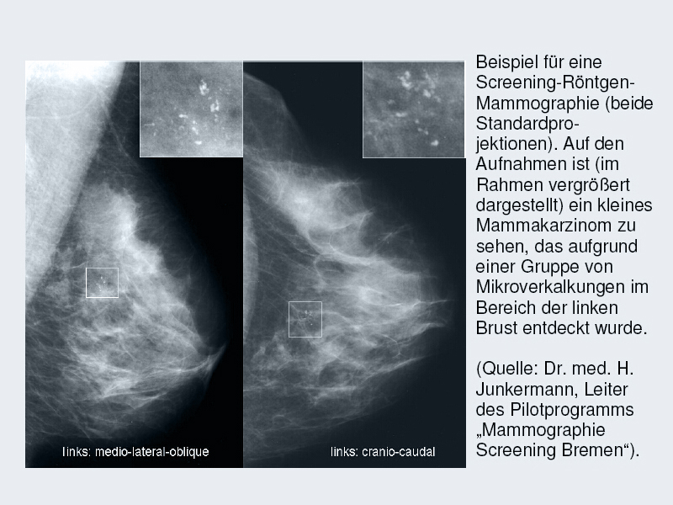
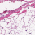
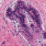
Rose’s Story cont.
Here she should have gone to the hospital to find out the truth of the matter, the doctor asked her to do a screening mammogram, and the shocking news was that she suffers from invasive ductal carcinoma (a type of breast cancer).

Slide 5
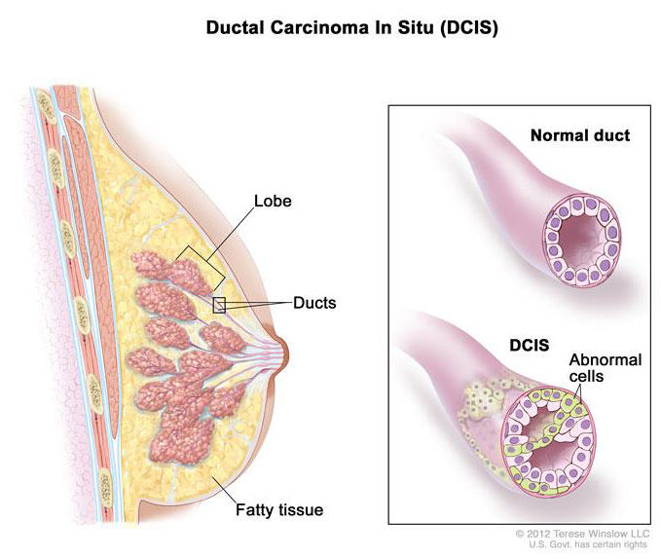
Breast Cancer
Breast cancer is the second leading cause of cancer deaths among U.S. women, it is a type of cancer that starts when cells begin to grow out of control
Most breast cancers begin in the ducts that carry milk to the nipple (ductal cancers)
It can spread when the cancer cells get into the blood or lymph system and are carried to other parts of the body.
Cancerous breast tumors are detected by a special type of examination, which is screening mammogram

Slide 6
Project headlines
Problem: Suffering from breast cancer
Objective: building a system for breast cancer detection using deep learning
Data: screening mammograms images
Technique: design thinking approach

Slide 7
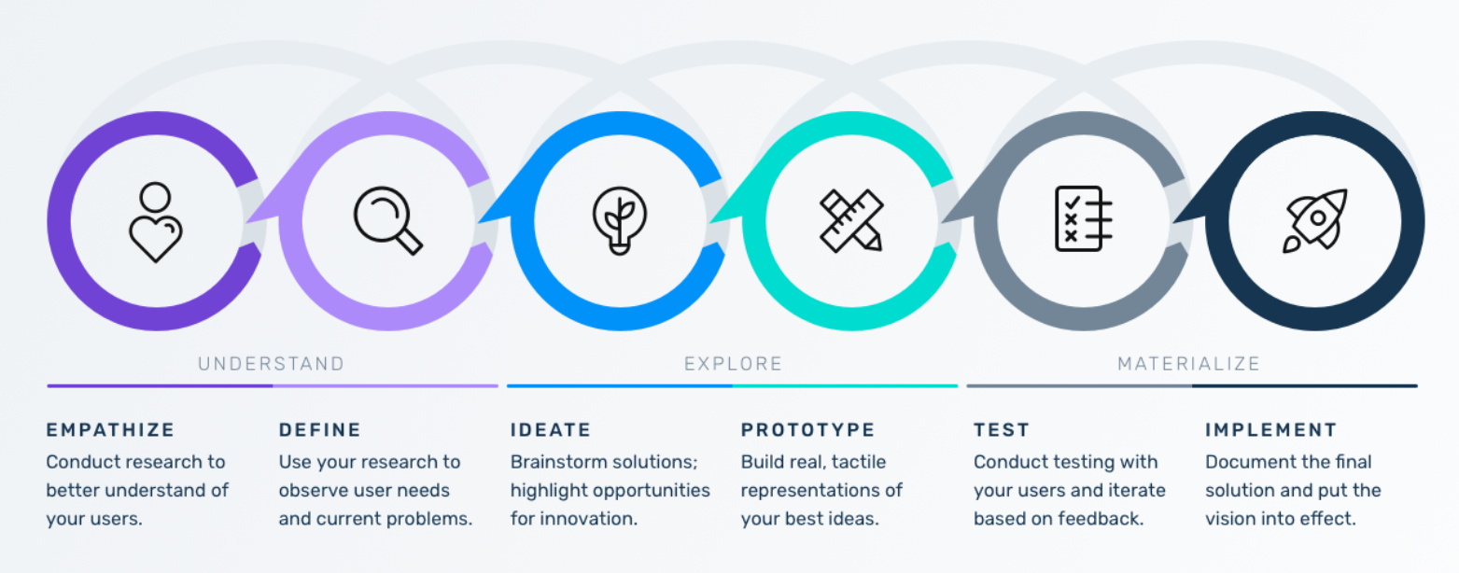
Design thinking

Slide 8
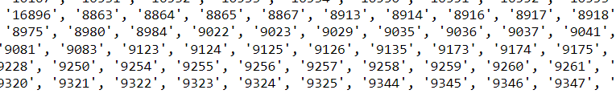
Working on our data
The structure of the data:
279 files for each patient named with their id, and each file contains mammograms images of its owner
To facilitate the process of dealing with screening mammograms images, we will collect all the images in one place “all_rays_dir ”, while retaining ownership of each image and its class as well...
Thus, we obtained 277,524 images!

Slide 9
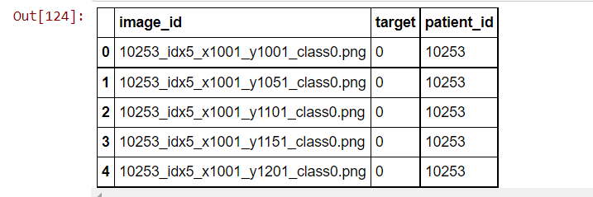
Then, it's time to put images in a data frame for easy access:

Slide 10
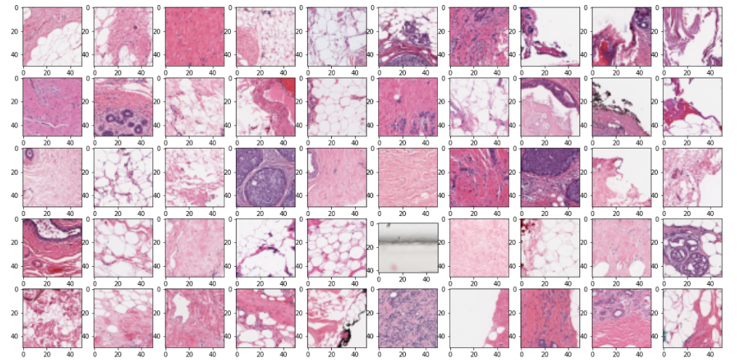
EDA: let's explore our data
First, let's take a look at the nature of mammograms...
- Healthy patches:

Slide 11
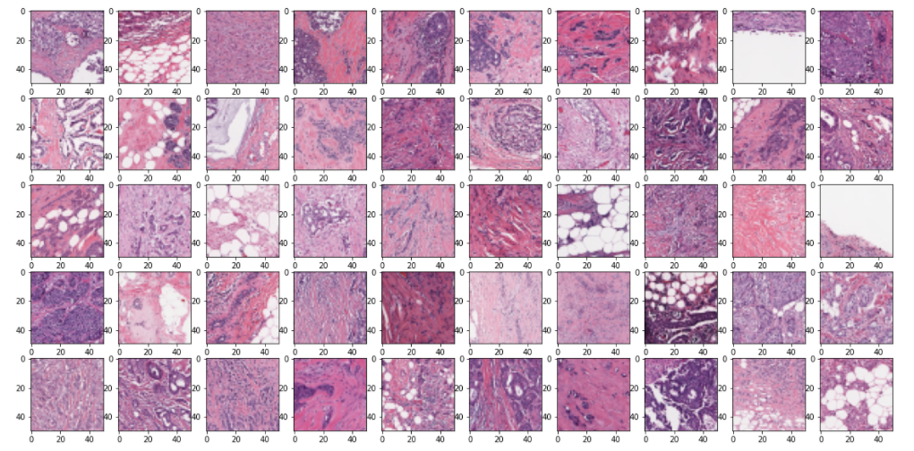
- Cancer patches:

Slide 12
Insights:
Most of the healthy mammograms are light pink, but there are some dark ones too.
Patches with cancer look more violet and crowded than healthy ones.
- In fact, we could not determine the actual difference between the two types with the naked eye, but I think that the model is able to detect hidden patterns in these images that enable us to determine the state of each image.

Slide 13
Using data analytics, we will get the answers..
Let's ask some questions that will help us get to know more our data:
do all patients have the same number of mammograms?
what is the percentage of cancer (IDC) that each mammogram shows?
how many healthy and cancered mammograms are in the data?

Slide 14
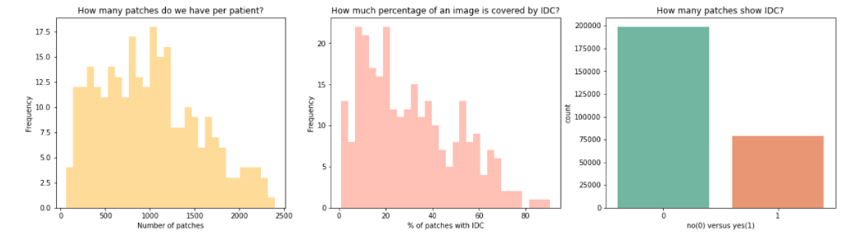
The number of image patches per patient varies a lot
Most of the photos have a percentage that is not large, but there are other photos that have a percentage of up to 80%
the smaller number of mammograms had cancer

Slide 15
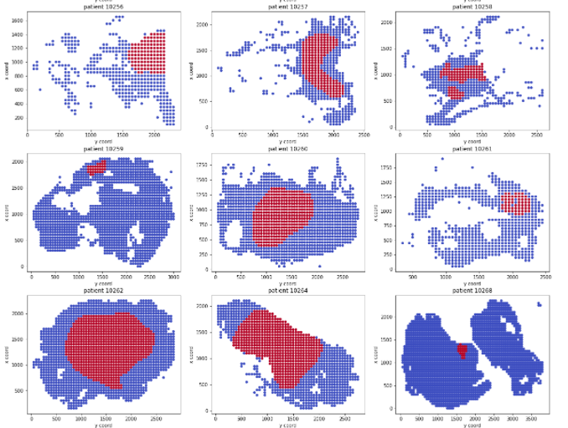
Well let's take a closer look at the shape of the patches and their distribution in each mammogram using Binary objective visualization for each tissue slice:
Insights:
We see a large variation in the concentration of cells
Sometimes we don't have the full tissue information. It seems that tissue patches have been discarded or lost during preparation.

Slide 16
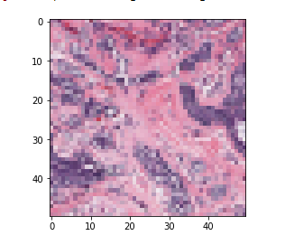
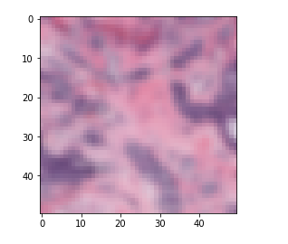
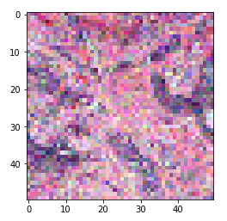
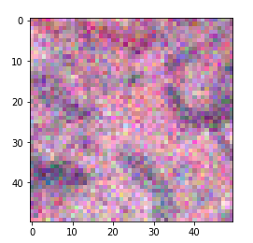
thinking about applying some processing properties on the images, maybe it can give us better results
Preprocessing
Normal
Gaussian filter
Random noise
Random noise on Gaussian

Slide 17
Processed and Normal images test
How do we know which pictures are better in modeling?
1- We chose an equal random sample of normal and processed images - 10,000 positive images and 10,000 negative images.
2- They were divided and entered into two simple models that have the same design and monitor the results
Results :
We found that the model handles normal images more accurately than processed images
Conclusion: normal images are used in the design of the main model

Slide 18
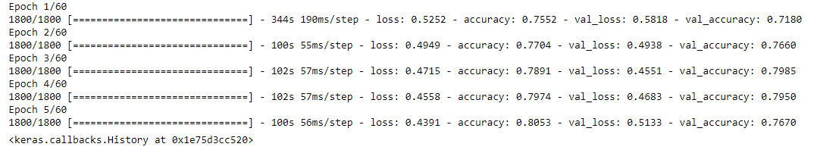
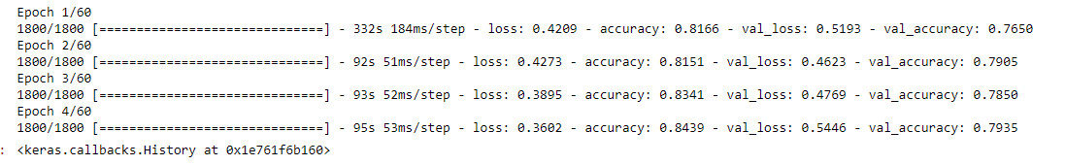
Applying model on preprocessed images, give results:
Testing the prepressing
Applying model on normal images, give results:
conclusion: Normal images are the best in modeling

Slide 19
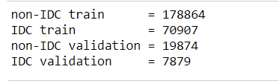
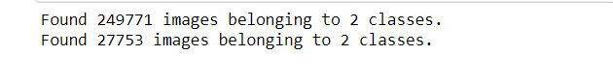
Model design
We implemented Convolutional Neural Networks (CNN)
We tried more than one design and they had problems with overfitting and small accuracy
We came up with this design with good accuracy
The data was divided into 90% training and 10% test, and then we passd it to the model

Slide 20
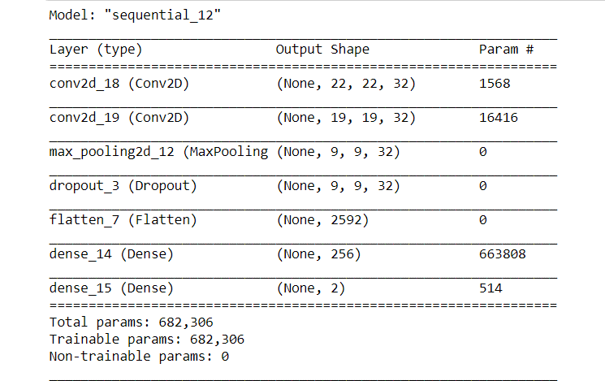
Model design
Model summary :

Slide 21
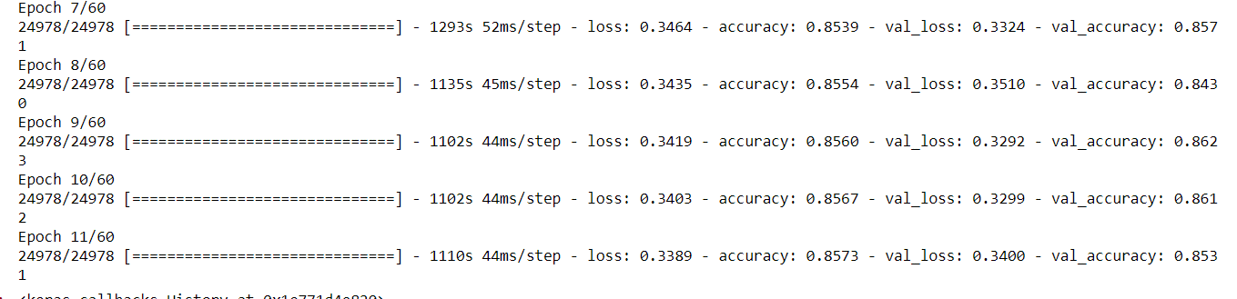
Model design
Model fitting :

Slide 22
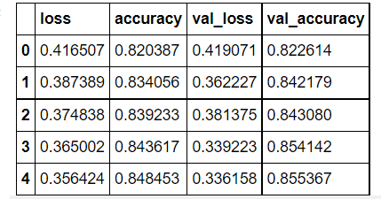
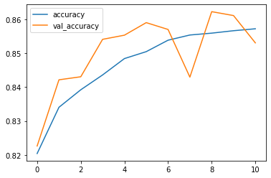
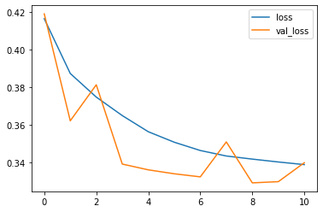
Test
History of model :

Slide 23
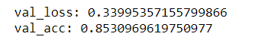
Model Outputs and Outcomes
Model Evaluation :
Model results :
After several attempts, we made a good model design
Our model have a good acc = 85.4 %
over fitting is so small
We're ready to save our model and create APIs

Slide 24
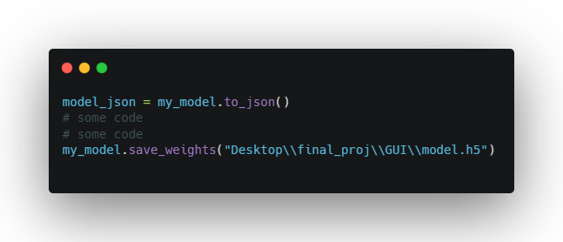
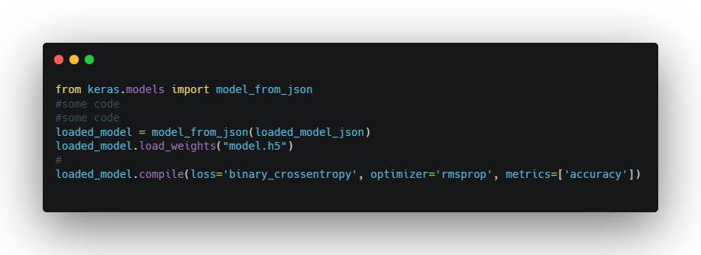
Save &Loaded Model
How was the model saved? :
How was the saved model retrieved?

Slide 25
APIs & Web
class Api_service()
Flask & my_wep_app routes
Save new data & results process
apply web app

Slide 26

APIs & Web:
Implement

Slide 27
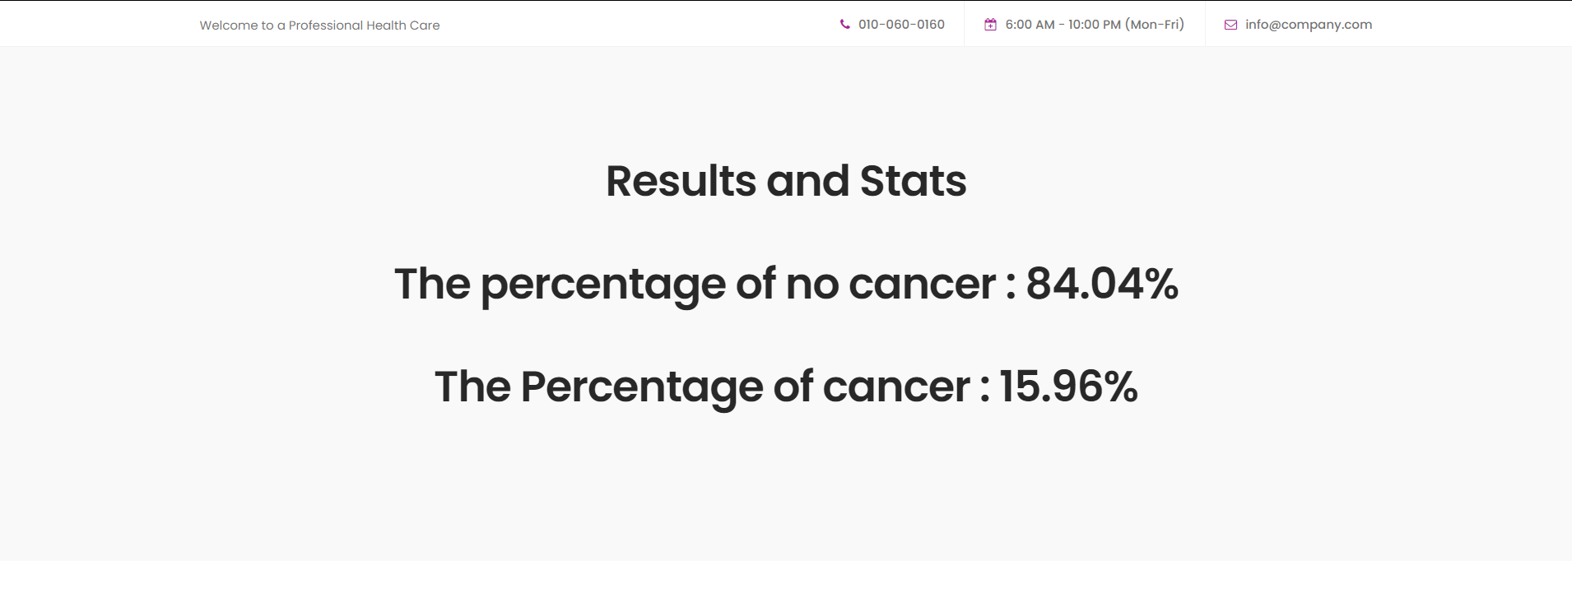
APIs & Web
Let's see and test the web application

Slide 28
Where is our code?
Our dataset : Breast Histopathology Images dataset
Our Notebook : Notebook
Our project in GitHub : GitHub

Slide 29

Thank you !
Samsung Innovation Campus

